Slide 1
Managing Conflict, Politics, and Negotiation
chapter seven
McGraw-Hill/Irwin
Contemporary Management, 5/e
Copyright © 2008 The McGraw-Hill Companies, Inc. All rights reserved.

Slide 2
Learning Objectives
Explain why conflict arises, and identify the types and sources of conflict in organizations.
Describe conflict management strategies that managers can use to resolve conflict effectively.
Understand the nature of negotiation and why integrative bargaining is more effective than distributive negotiation.
Describe ways in which managers can promote integrative bargaining in organizations
Explain why managers need to be attuned to organizational politics, and describe the political strategies that managers can use to become politically skilled.
17-<number>

Slide 3
Question?
What is the discord that arises when goals of different individuals are incompatible?
Disagreement
Incongruity
Discrepancy
Conflict
17-<number>
Notes:
The correct answer is “D” – conflict. See next slide.

Slide 4
Conflict management
Managing in the domestic and global environment requires understanding and adapting to the unique challenges and opportunities that arise in each context. While domestic management focuses on operations within a single country, global management involves dealing with the complexities of operating in multiple countries and diverse cultural settings. Here are some key considerations for
17-<number>

Slide 5
Organizational Conflict
The discord that arises when goals, interests or values of different individuals or groups are incompatible and those people block or thwart each other’s efforts to achieve their objectives.
  Conflict is inevitable given the wide range of goals for the different stakeholder in the organization.
17-<number>

Slide 6
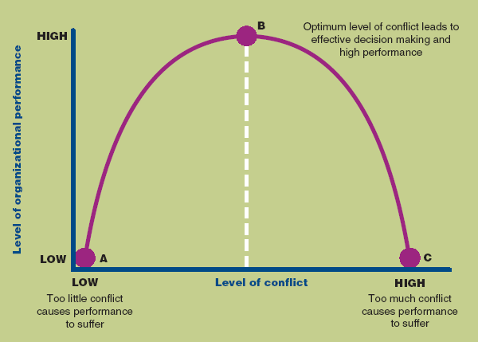
The Effect of Conflict on Organization Performance
Figure 17.1
17-<number>

Slide 7
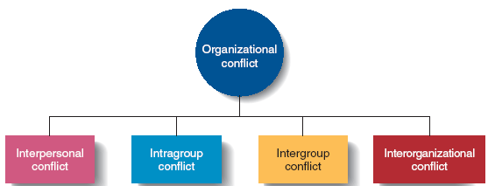
Types of Conflict
Figure 17.2
17-<number>

Slide 8
Question?
What is conflict between two or more teams?
Interpersonal Conflict
Intragroup Conflict
Intergroup Conflict
Interorganizational Conflict
17-<number>
Notes:
The correct answer is “C” – intergroup conflict. See slide 17-12.

Slide 9
Types of Conflict
Interpersonal Conflict
  Conflict between individuals due to differences in their goals or values.
Intragroup Conflict
  Conflict within a group or team.
Intergroup Conflict
  Conflict between two or more teams, groups or departments.
  Managers play a key role in resolution of this conflict
Interorganizational Conflict
  Conflict that arises across organizations.
17-<number>

Slide 10
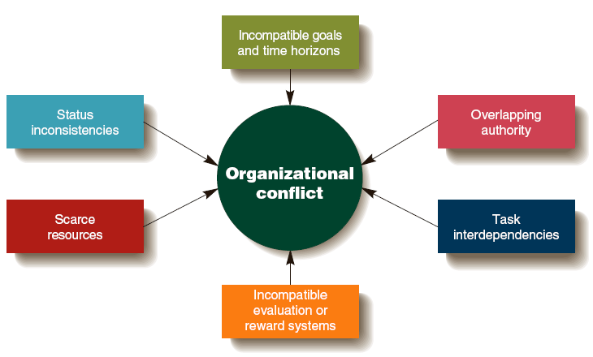
Sources of Conflict
Figure 17.3
17-<number>

Slide 11
Sources of Conflict
Different Goals and Time Horizons
  Different groups have differing goals and focus.
Overlapping Authority
  Two or more managers claim authority for the same activities which leads to conflict between the managers and workers.
Task Interdependencies
  One member of a group or a group fails to finish a task that another member or group depends on, causing the waiting worker or group to fall behind.
17-<number>

Slide 12
Sources of Conflict
Different Evaluation or Reward Systems
  A group is rewarded for achieving a goal, but another interdependent group is rewarded for achieving a goal that conflicts with the first group.
Scarce Resources
  Managers can come into conflict over the allocation of scare resources.
Status Inconsistencies
  Some individuals and groups have a higher organizational status than others, leading to conflict with lower status groups.
17-<number>

Slide 13
Conflict Management Strategies
Functional Conflict Resolution
  Handling conflict by compromise or collaboration between parties.
Compromise
  each party is concerned about their goal accomplishment and is willing to engage in give-and-take exchange to reach a reasonable solution.
Accommodation
  one party simply gives in to the other party
17-<number>

Slide 14
Conflict Management Strategies
Collaboration
  parties try to handle the conflict without making concessions by coming up with a new way to resolve their differences that leaves them both better off.
Avoidance
  two parties try to ignore the problem and do nothing to resolve the disagreement
Competition
  each party tries to maximize its own gain and has little interest in understanding the other’s position
17-<number>

Slide 15
Strategies Focused on Individuals
Increasing awareness of the sources of conflict
Increasing diversity awareness and skills
Practicing job rotation
Using permanent transfers or dismissals when necessary
17-<number>

Slide 16

Strategies Focused on the Whole Organization
Changing an organization’s structure or culture
Altering the source of conflict
17-<number>

Slide 17
Negotiation
Negotiation
  Parties to a conflict try to come up with a solution acceptable to themselves by considering various alternative ways to allocate resources to each other
Third-party negotiator
  an impartial individual with expertise in handling conflicts
  helps parties in conflict reach an acceptable solution
17-<number>

Slide 18
Third-party Negotiators
Mediators
  facilitates negotiations but no authority to impose a solution
Arbitrator
  can impose what he thinks is a fair solution to a conflict that both parties are obligated to abide by
17-<number>

Slide 19
Distributive Negotiation
Distributive negotiation
  Parties perceive that they have a “fixed pie” of resources that they need to divide
  Take a competitive adversarial stance
  See no need to interact in the future
  Do not care if their interpersonal relationship is damaged by their competitive negotiation
17-<number>

Slide 20
Integrative Bargaining
Integrative bargaining
  Parties perceive that they might be able to increase the resource pie by trying to come up with a creative solution to the conflict
  View the conflict as a win-win situation in which both parties can gain
  Handled through collaboration or compromise
17-<number>

Slide 21
Discussion Question
What is the most important strategy for encouraging integrative bargaining?
Focusing on the problem, not the people
Focusing on interests, not demands
Creating new options for joint gain
Focusing on what is fair
17-<number>
Notes:
All are important. Students should be familiar with each strategy.

Slide 22
Strategies to Encourage
Integrative Bargaining
Emphasizing superordinate goals
  goals that both parties agree to regardless of the source of their conflict
Focusing on the problem, not the people
Focusing on interests, not demands
Creating new options for joint gain
Focusing on what is fair
17-<number>

Slide 23
Organizational Politics
Organizational Politics
  The activities managers engage in to increase their power and to use power effectively to achieve their goals or overcome resistance or opposition.
Political strategies
  Specific tactics used to increase power and use it effectively to influence and gain the support of other people while overcoming resistance
17-<number>

Slide 24
The Importance of Organizational Politics
Politics
  Can be viewed negatively when managers act in self-interested ways for their own benefit.
  Is also a positive force that can bring about needed change when political activity allows a manager to gain support for needed changes that will advance the organization.
17-<number>

Slide 25
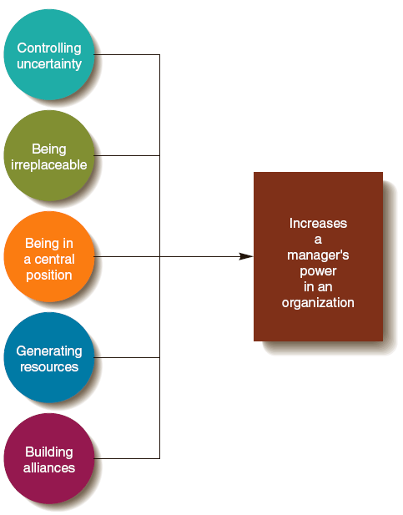
Political Strategies for Increasing Power
Figure 17.4
17-<number>

Slide 26
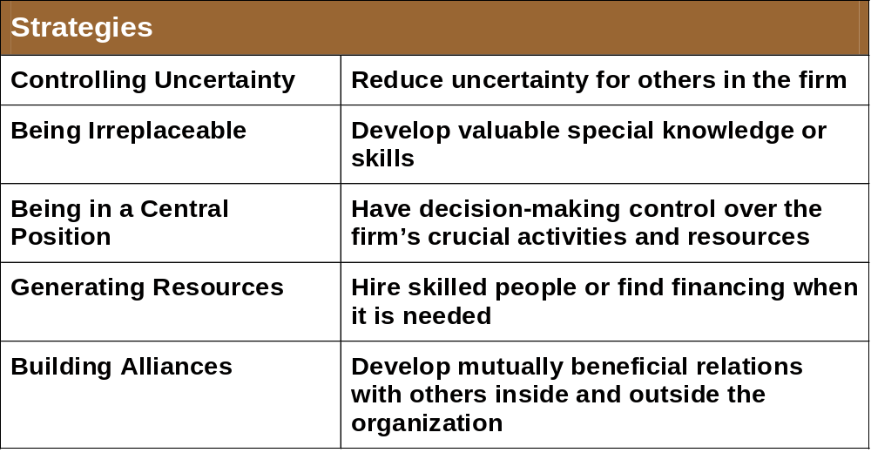
Political Strategies for Gaining and Maintaining Power
17-<number>

Slide 27
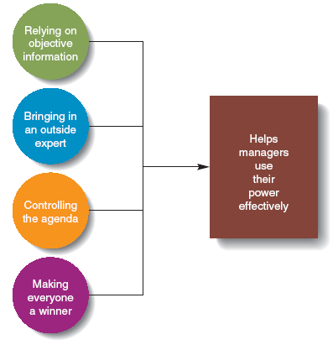
Political Strategies for Exercising Power
Figure 17.5
17-<number>

Slide 28
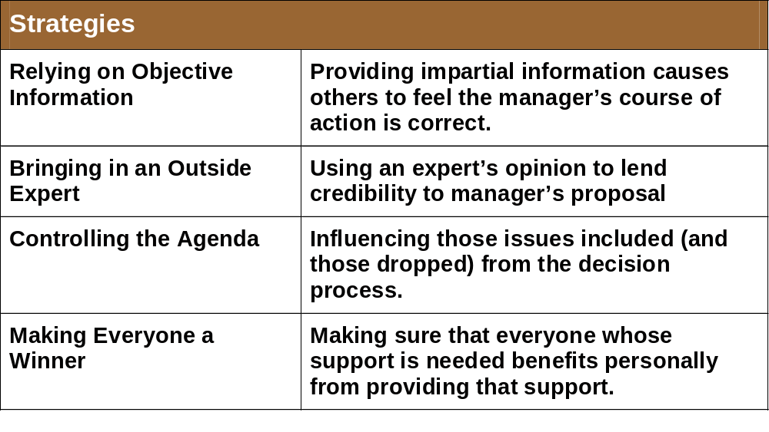
Strategies for Exercising Power
17-<number>

Slide 29

Movie Example: Jaws
How does Chief Brody handle the conflict of closing the beaches with the townspeople?
17-<number>
Notes:
The New England shore community of Amity is being terrorized by a Great White shark. Chief Brody (Roy Schneider) wants to close the beaches to protect the tourists and the locals. The locals are worried that closing the beaches will hurt their businesses. Students may discuss how compromise, collaboration, avoidance and accommodation apply to this conflict.

